Slide 1





A Neuroinclusive Future
GAIN Strategy 24 - 27

Slide 2

Achievements and Progress
  Insurance industry design thinking workshops
  Virtual launch, October 2021
  8 Founder Funders
2021
  Hire of the first GAIN employee
  GAIN membership launch June 2022
  First GAIN member events, including IFN collaborations
  First individual member survey
  9 Corporate members and 275 Individual members
2022
  2 further employees join GAIN
  Launch of the GAIN industry benchmark, mentorship pilot, podcast, and “Bite Size” series
  66 events run in 2023, including IFN, iCAN and IGPP collaborations and partnered with the Diversity Project
  NCW, WAAW, and ADHD Awareness Month Campaigns
  25 Corporate members and 1,092 Individual members
2023
  NCW & WAAW Pathways to Neuroinclusion Campaign
  Supported the UN/ION WAAD Campaign
  Launch of the monthly corporate member round table
  Release of findings from early GAIN industry benchmarks
  42 Corporate members, 1,285 Individual members, and 3600 LinkedIn subscribers by end Q1 2024
  Now a CII Accredited Partner
2024
www.reallygreatsite.com
reallygreatsite.com
4
Achievements and Progress

Slide 3

GAIN as a Hub
Providing safe spaces, support and guidance to neurodivergent individuals, and learning from their experiences.
Identifying and utilising the latest knowledge to help individuals and businesses succeed.
Individual
Members
Research
Corporate
Members
Service
Providers
Working with businesses to create neuroinclusive workspaces and implement inclusive working practice.
Access our suite of service providers who can partner with businesses and individuals to create neuroinclusive workspaces.

Slide 4
A Neuroinclusive Future: Our Strategy
Our Vision is a world where insurance and investment businesses benefit from being places where neurodivergent individuals thrive and belong.
Our Mission is to spark an industry-owned and industry-led radical improvement in the employment prospects of neurodivergent people in insurance, investment, and related areas of financial services.
Our Values
Our values are to protect, nurture, equip, and enable.
  We protect by providing psychological safe places within our sector that enable individuals to thrive, and future-proofing the industry by improving the talent pool by including different thinking.
  We nurture a community that supports and uplifts individuals by enabling a collective voice, and helps businesses thrive by creating neuro-inclusive workplaces.
  We equip neurodivergent individuals to succeed in employment by creating pathways and programmes with the help of specialist service providers, and similarly equip corporates to recruit, retain, and develop neurodivergent individuals.
  We enable neurodivergent individuals to experience improved employment prospects and a community of our sector’s employers to benefit from a workforce that matches persistent talent gaps and mobilises teams, reshapes cultures, and improves outcomes through diversity of thought.

Slide 5
A Neuroinclusive Future: What sets GAIN Apart
  Industry Knowledge & Ownership: Deep and broad expertise of our specific industry sectors, their leaders and shapers, their practices, goals, and challenges. We are owned by the industry for the industry.
  Neurodiversity Inclusive: Thinking about neurodiversity inclusively, covering all its forms and all its intersections.
  Neurodiversity at Work: Focusing on people’s working lives, including people in mid-late careers working without diagnosis or support.
  Neurodiversity & Community Led: GAIN’s community is our strength and voice, and at the heart of all we do.

Slide 6
The GAIN Strategy: Our Goals
  Further broadening the belief within our industry that its talent needs match the talents and skills of neurodivergent people, and that there is business advantage in measures to attract, develop, and retain those people.
  Creating safe spaces to foster the wellbeing and belonging of ND individuals within the industry, and to generate insights for change based on their experiences.
  Working in collaboration with corporate members, individuals, and service providers to co-design and test workplace practices to improve opportunities for the talent, skills, and abilities of neurodivergent individuals.
  Designing and enabling ways for businesses and neurodivergent individuals to find one another through making existing talent pipelines more neuroinclusive and by creating new ones.

Slide 7
The GAIN Strategy: A Transformed Industry
  Businesses which are more efficient and productive through benefiting from ND talent.
  Products and services that better benefit society because they are designed to
be neuroinclusive.
  A neuroinclusive reputation which sees the industry workforce include a proportion of ND employees that measurably exceeds the proportion in the working-age population.
  Inclusive approaches to continuous learning and talent development which lead to equal neurodivergent representation at all levels of seniority.
  Performance management, working patterns, environments and adaptations that eliminate any pay gap between neurodivergent and neurotypical employees.

Slide 8
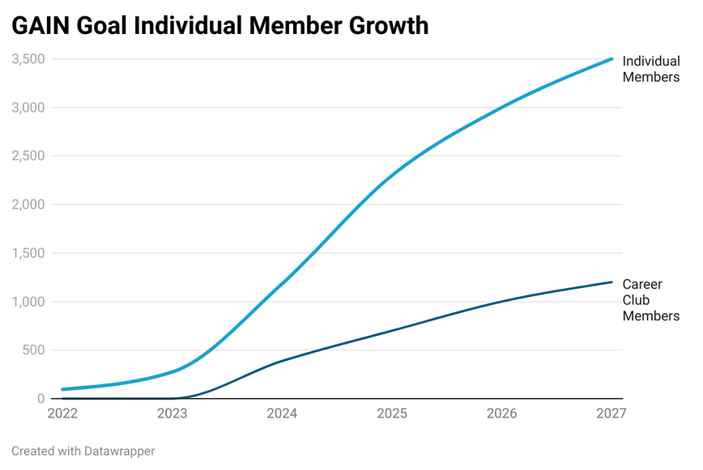
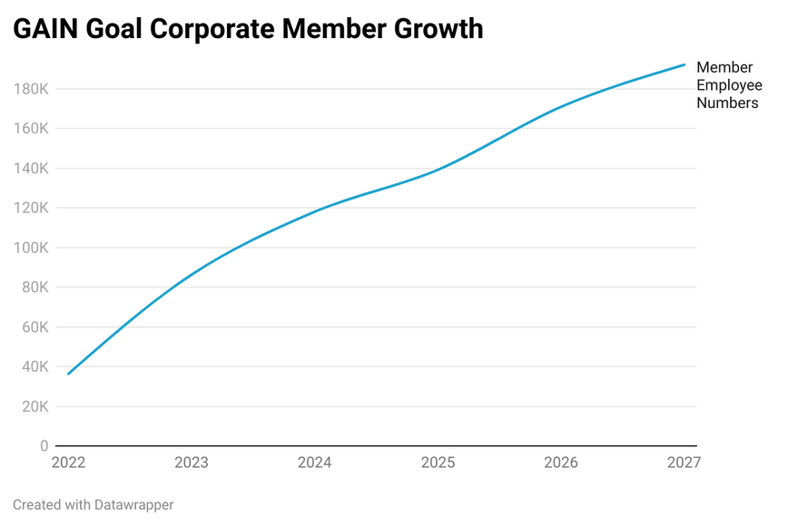
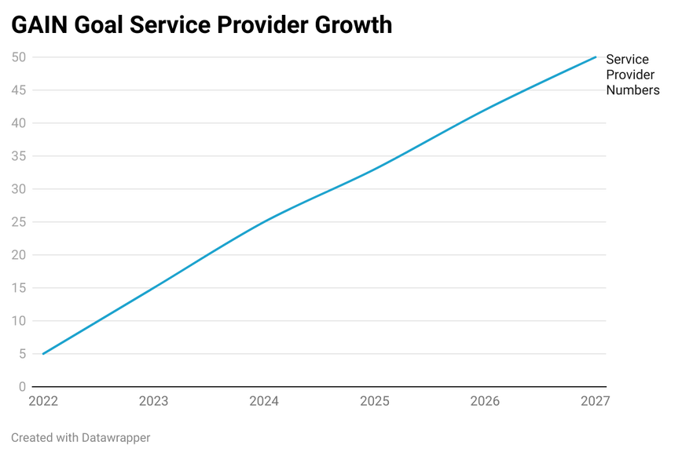
Measurable Outcomes
www.reallygreatsite.com
reallygreatsite.com
19

Slide 9
Gaining Momentum: The Business Plan
Taking a step-by-step approach, we believe transformation is possible. Moving our industry towards neuroinclusion requires a collective effort based around a well thought through plan that will:
  help the sector contribute to the national ambitions outlined in the Buckland Review.
  create opportunities for individual members to thrive.
  create value for corporate members at different stages of their neuroinclusion journey.
  identify change by measuring progress.

Slide 10
Pathways to Neuroinclusion
Ignorance
Awareness
Learning
Mastery
Building Belief
Inclusive Workspaces
Talent Streams
Harnessing Expertise
Key figures, eg senior leaders, HR, and Employee Resource Gsoups (ERG) are unaware or disinterested in the value of neurodiversity, Neurodivergent employees lack psychological safety.
Becoming aware of the value of neuroinclusion. The stage where a company typically joins GAIN. Interested in quick wins and easy access content.
Individuals at all levels are invested in neurodiversity. Member has capacity and desire to engage in more complex learning and transformative projects.
Feeling confident to share combined knowledge and learning, developing best practice, and acting as an ambassador or thought leader in the industry.
Generic activities and events, quick-win participation, on-demand resources and content
Benchmarks, projects and pilots, research, and more interactive activites such as Volunteer Working Groups and workshops
Leading on pilots, representing the GAIN community, hosting events and contributing to best practice playbooks
Public events, outreach and awareness-raising activities. Individual employees may subscribe to GAIN
The Corporate Journey

Slide 11


A Thriving Community
Individual Moments that Matter - Growing Talent Streams
Attracting Neurodiverse Talent
Inclusive Recruiting
Inclusive Workspaces
Neuroinclusive Progression
Inclusive Leadership
Graduates,
Internships,
Apprenticeships,
Career Returners,
Career Changers,
Pathways from Unemployment and
Promotion of the Industry.
Inclusive Job Ads,
Interview Best Practice,
Selection Best Practice,
HR and Hiring Manager Skills.

Slide 12
A Thriving Community
Individual Moments that Matter - Developing Neuroinclusive Workspaces
Inclusive
Recruiting
Inclusive
Workspaces
Neuroinclusive Progression
Attracting Talent
Inclusive Leadership
Inclusive Onboarding,
Inclusive Inductions,
and Accessibility Passports.
Physical Space Adjustments,
Diagnosis Support,
Safe Spaces,
Line Manager Skills,
Managing Neurodiverse Teams, and
EWG Support.
Inclusive Reviews, Appraisals, and Performance,
Continuous Learning,
Accessible Qualifications, and
Neurodivergent Leadership.
www.reallygreatsite.com
reallygreatsite.com

Slide 13

An Industry Moving Forward - The GAIN Strategy
A Focused Approach
Building Belief in the benefits of neuroinclusion. Broadening the belief within of the talent match with neurodivergent people, and that there is business advantage in measures to attract, develop and retain those people.
Developing Neuroinclusive Workspaces. Creating safe spaces to foster the wellbeing and belonging of ND individuals within the industry, and to generate insights for change
based on their experiences.
Harnessing Expertise.
Harnessing and showcasing expertise from among specialist service providers, as part of a collaborative approach with our members, as well as the expertise and insight of our community.
Growing Talent Streams.
Designing and enabling ways for businesses and neurodivergent individuals to find one another through making existing talent pipelines more neuroinclusive and by creating new ones.

Slide 14

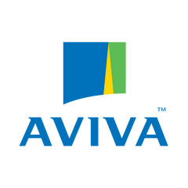






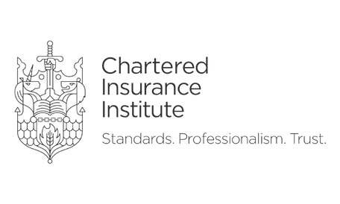





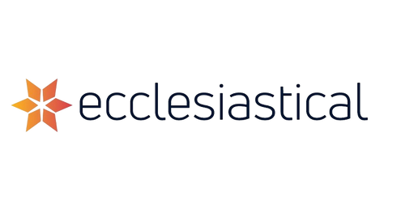


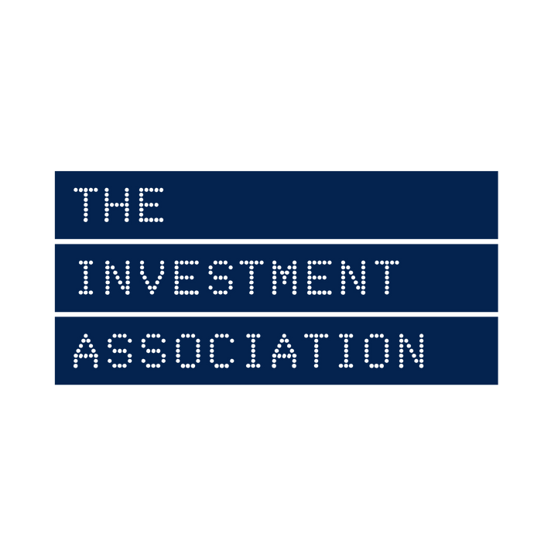






















Our Corporate Members
39

Slide 15
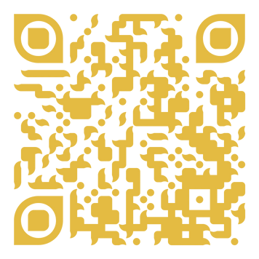
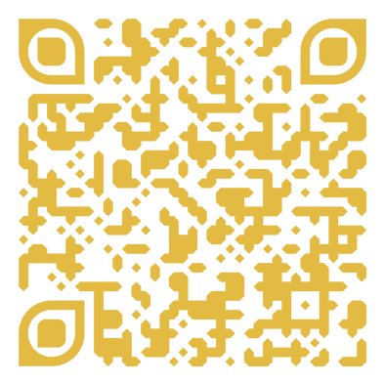
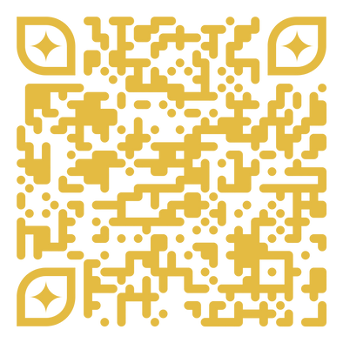
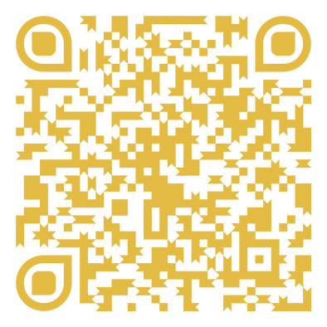
Become a part of the neuroinclusive journey
Executive Summary
Sponsorship Opportunities
Corporate Membership
Individual Membership
info@gaintogether.org | gaintogether.org
2024. All rights reserved by GAIN Community Interest Company. Registered in England No. 13351142t

