Slide 1

NEDs and Digital Technology
Neil Tinegate
AFM NED Conference
1st July 2024
Neil Tinegate

Slide 2
Deloitte Corporate Leaders Survey
Q: Is your board’s oversight of technology matters sufficient in both scope and depth?
Source: The Deloitte Global Boardroom Program’s Digital Frontier: A technology deficit in the boardroom (2022)

Slide 3
NEDs and Digital Technology
Neil Tinegate
AFM NED Conference
1st July 2024
Neil Tinegate

Slide 4

Digital Transformation - NED Approach
Guide the vision by being a cultural champion
Shape the strategy
Help the team to hold the course

Slide 5
Strategic Tech vs Digital Transformation
 | Technology as a Strategic Asset | Digital Transformation
Focus | Leveraging technology to achieve strategic goals | Broad organisational shift enabled by technology
Scope | Individual technology investments | Holistic change across the organisation
Key Concepts | ROI Alignment with Strategy Project Management | Customer-Centricity Data-Driven Decision Making Agile Culture Upskilling Workforce

Slide 6

Strategic Tech Initiatives - NED Approach
Consult technology experts, ask questions
Understand the governance framework
Assess talent and capability

Slide 7
NEDs and Digital Technology
Neil Tinegate
AFM NED Conference
1st July 2024
Neil Tinegate

Slide 8
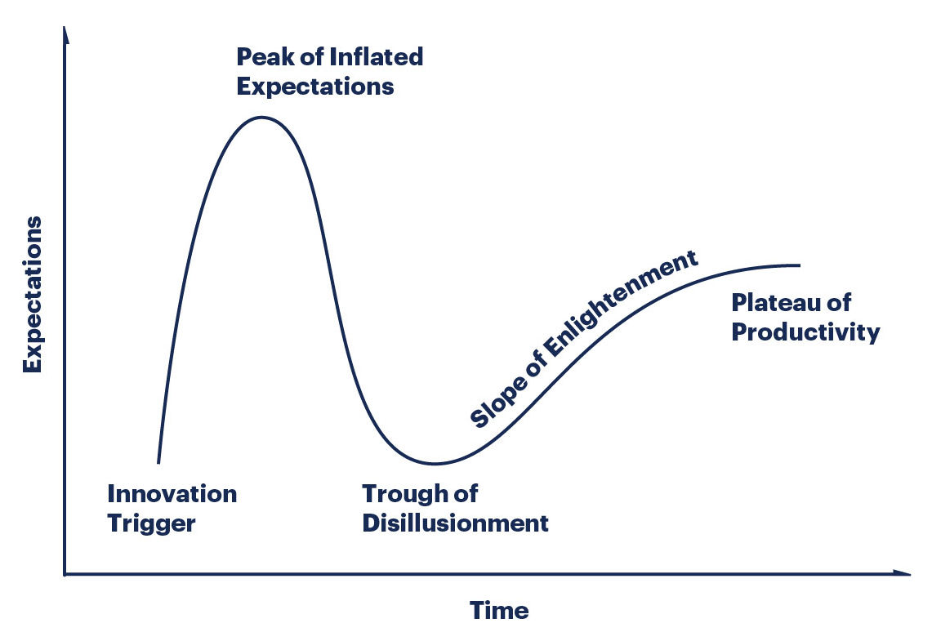
Gartner Hype Cycle

Slide 9
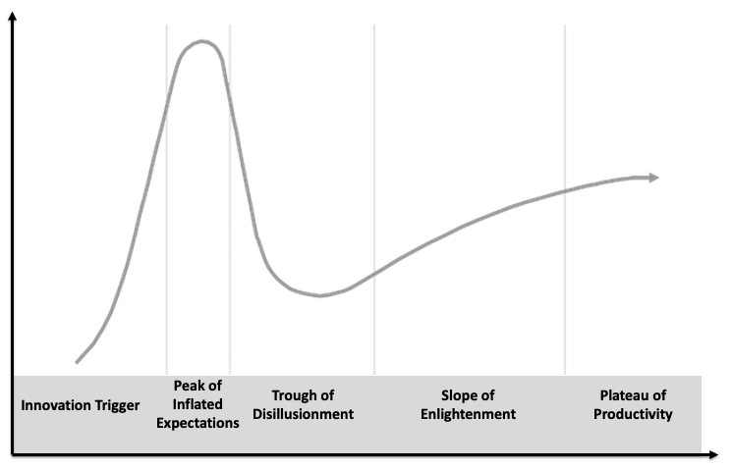
Gartner Hype Cycle
Generative AI
Narrow AI
Diagnostic AI

Slide 10
Gartner Hype Cycle
Generative AI
Narrow AI
Diagnostic AI
Metaverse

Slide 11
Gartner Hype Cycle
Generative AI
Narrow AI
Diagnostic AI
Blockchain
Metaverse

Slide 12
Gartner Hype Cycle
Generative AI
Narrow AI
Diagnostic AI
IoT
Blockchain
Metaverse

Slide 13
Gartner Hype Cycle
Generative AI
Narrow AI
Diagnostic AI
IoT
Blockchain
Metaverse
Quantum
Computing

Slide 14

Emerging Tech - NED Approach
Keep it strategic
Make informed decisions
Keep eyes open

Slide 15
NEDs and Digital Technology
Neil Tinegate
AFM NED Conference
1st July 2024
Neil Tinegate

Slide 16
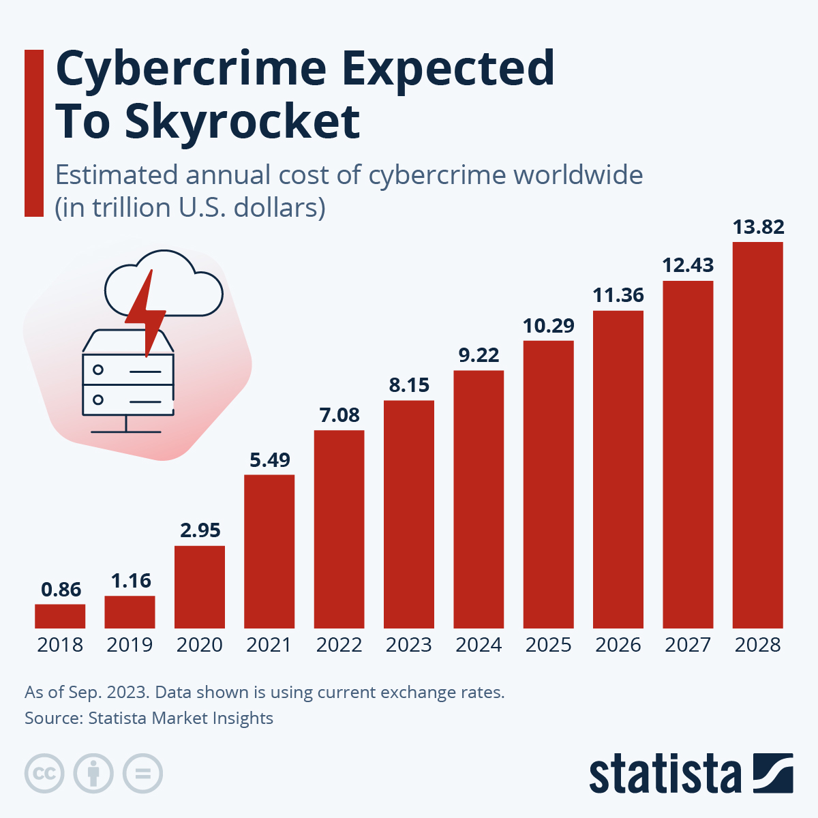

Slide 17

Cyber Security - Strategic Approach
Develop the culture
Understand the threat
Manage the risk

Slide 18

https://www.ncsc.gov.uk/

Slide 19
NEDs and Digital Technology
Neil Tinegate
AFM NED Conference
1st July 2024
Neil Tinegate

